Slide 1
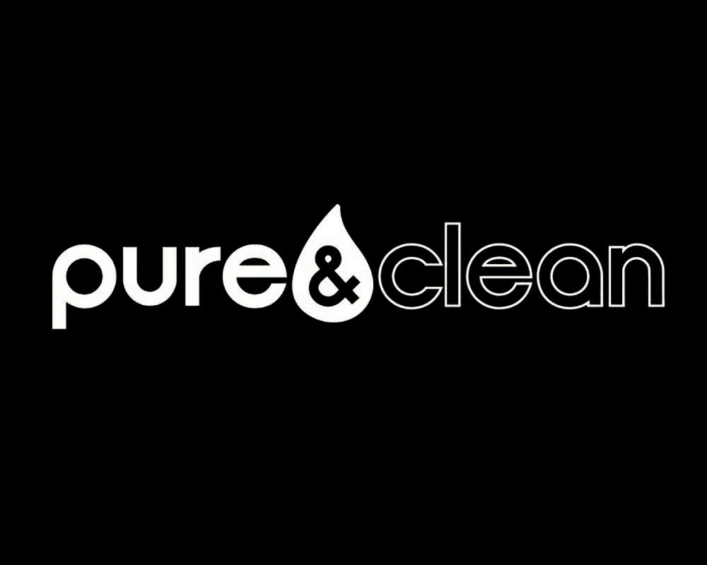
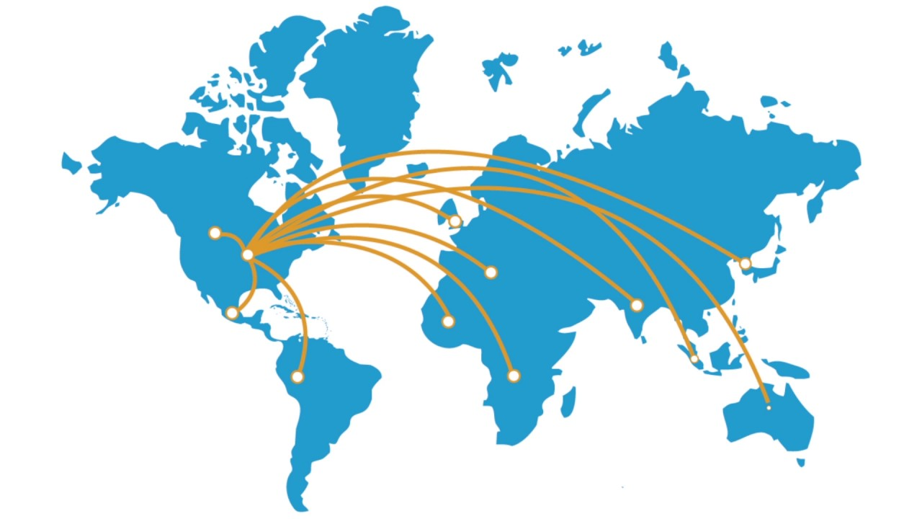
Overseas Expansion of
Dallas Capitalists:
Sriram Kumar Reddy Challa - sxc190047@utdallas.edu
Venkata Narayana Ega - vxe180003@utdallas.edu
Jaswanth Pedapalli - jxp190002@utdallas.edu
Patty Phewklieng - ppp180003@utdallas.edu
Raelynn Robinson - rmr200000@utdallas.edu

Slide 2
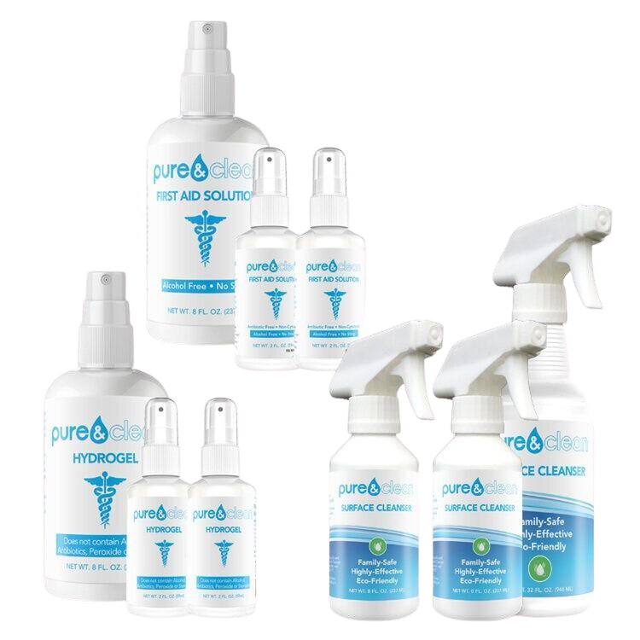
Pure & Clean
Pure and Clean LLC was founded in 2013 out of Nixa, Missouri
Mission: To change global healthcare by providing disinfectant, sanitizer, and wound care products that are non-toxic.
What is Hypochlorous Acid? A molecule naturally produced by the human’s bodies white blood cells that is 100 times more effective than bleach.
Pure and Clean doubled their revenue in the month of March 2020 alone surpassing the entire year of 2019 amidst the COVID-19 pandemic.

Slide 3
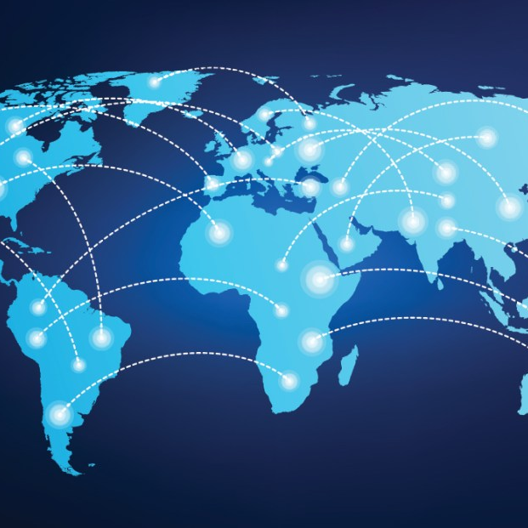
Current and Potential Markets
Vertical Markets: Sports and schools, medical (wound care), eyes, and COVID-19.
Company expand to fulfill domestic demand
No measures have been taken to address the foreign demand
Limited expertise on exporting overseas
Inquiries from international markets in the Middle East - Turkey and Oman - interested in Pure and Cleans products.
Turkey: Trade plays an important role in the economy where the value of exports and imports of goods and services equals 60.4% of GDP.
Oman: Government is working to diversify the economy by encouraging foreign investment

Slide 4

Overseas Market Size
Market Growth
How can Pure and Clean enter foreign markets while maximizing profit and minimizing risk?
64% of the combined population in Turkey and Oman use sanitizing products
56% use bleach products and 30%-35% use HOCl products
HOCl is more expensive but non-toxic
HOCl products in Turkey and Oman are more costly than in other countries
Target market : 20 million consumers for surface cleaners
: 2.1 million customers for wound management products
Current global HOCl market size: USD 3.96 billion
Expected to reach USD 4.98 billion by 2026
Compound annual growth rate (CAGR) : 3.3% during 2021-2026
Pre COVID-19, HOCl maintained a steady growth
Post outbreak, the market has seen enormous growth with an exponential CAGR rate

Slide 5

Distribution Strategies
Direct Exports
Indirect Exports
Ex Work Shipping
What is it? | Pure and Clean sells their products directly to an international customer | Pure and Clean sells their products to an intermediary within the US. The intermediary is responsible for paperwork, permits, shipping & marketing They sell the products in the foriegn market | Pure and Clean drops their products at a designated location Buyer is responsible for transporting the goods, paying the import and duties taxes as well as marketing and dispensing the products.
Advantages | Better control over distribution Expand market share overseas | Focuses on production Avoids most hassles associated with exporting | Reduces risk for seller Least costly method of exporting overseas
Disadvantages | High transportation cost for bulky products Protectionism Expenses may not be recouped if the venture is unsuccessful | Less control over distribution Inability to learn how to compete overseas | Buyer is in control of entire shipment Inability to learn how to compete overseas
Suitable for Pure & Clean? | Potentially in the future | No | Yes

Slide 6


Case Analysis
The company is currently in its growth stage and does not have the financial resources to spend a substantial sum of money exporting products overseas.
Direct exporting would incur protectionism costs. In Turkey, the import tax is currently 18%. For a pallet of disinfectant, which costs $12,481.50, the import tax would be $2,246.
Indirect exporting requires hiring an intermediary. The average intermediary charges a fee ranging between $750-$1,000 for each shipment
EXW however requires the buyer to taken on responsibility for the goods' price, sales taxes, shipping costs, and export license. Pure and Clean’s only cost would be transporting their products to their port of choice.
EXW shipping does not require the company to invest time in familiarizing themselves with a foreign market nor do they incur any additional expenses such as hiring an intermediary.
GLOBAL

Slide 7
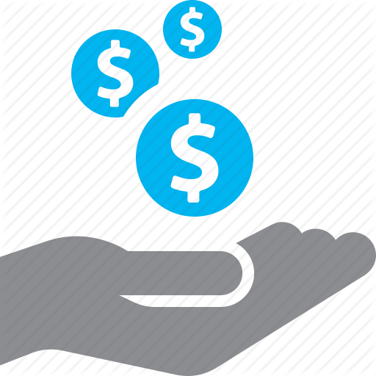
Conclusion
Different distribution strategies differ in terms of cost, commitment, risk, return, and control.
EXW allows the buyers to control the entire shipment process and outlines the costs upfront where cost and liabilities fall within the buyer allowing minimum responsibilities and cost to the seller.
Both Turkey and Oman have a strong demand for Pure and Clean products making EXW the easiest and most cost-effective mode of entry.
Minimum cost, risk, and responsibilities for Pure and Clean by using EXW.
Direct exporting should be reevaluated if the Middle Eastern market proves to be successful.
Direct exporting would allow Pure and Clean to acquire knowledge on how trade is conducted overseas and give them better control over distribution.

Slide 8
Questions
1
If you were the CEO of Pure and Clean, would you support the idea of overseas expansion?
2
From a resource-based view, does Pure and Clean have the necessary resources and capabilities to participate in international trade?
3
For Pure and Clean, how does the country-of-origin image affect Turkey and Oman's market?

